Slide 1


Degrees of Climate Change Project Summary
5 June 2018
Todd Schultz, Rahul Birmiwal, Abhishek Anand

Slide 2
Outline
Background
User persona/Research Questions
Data Sources
Demo
Design
Project Structure
Lessons learned and future work

Slide 3
Background
Climate change, fundamentally, is defined by
Historical changes in statistical properties of a climate system(s)
Often measured by sample mean/sample variance (spread) of historical global temperatures
Does climate change equal global warming and what caused it?
Ramifications reach to the basic ability of Earth to support life
Corrections cost enormous sums of money
Corrections threaten entire industries and nations

Slide 4
Background
Potential bias in the data
Independent databases, such as the World Bank, are “centrist“?
NOAA or Berkeley Earth, given their sources of funding, are biased towards data evincing global warming?
China, Russia, the Middle East, whose economies wholly depend on the prolonged sustenance of oil, tend towards conservative climate estimates?
So what is the truth?
And who watches the watchers?

Slide 5
Sally the Scientist, Activist
Concerned about climate change
Professional scientist, engineer, or mathematician
Self exploration
Novice with computer languages
Novice with web service technology

Slide 6
Research Questions/Use Cases
What is the average global temperature from a certain agency?
How does the estimates from various agencies compare?
How do I get or add another agency’s estimate?
What other quantities correlate to the average global temperature?

Slide 7
Data Sources
Temperature Data
NOAA (https://www.ncdc.noaa.gov/cag/global/time-series)
Berkeley Earth (http://berkeleyearth.org)
The World Bank (http://data.worldbank.org)
Carbon Dioxide Data
Scripps Institute of Oceanography (https://scripps.ucsd.edu/)

Slide 8
Data Sources
Obtaining Data
grab_ functions
Pandas read_html() / read_csv()
Access via API token and requests library
Clean and output into dataframe
Data Limitations
Some sources have many NULL / missing values
Time horizons of data varied greatly from Berkeley to WorldBank
Attempted to obtain hard-to-find data from some agencies (Chinese Government, EU, Department of Energy)

Slide 9
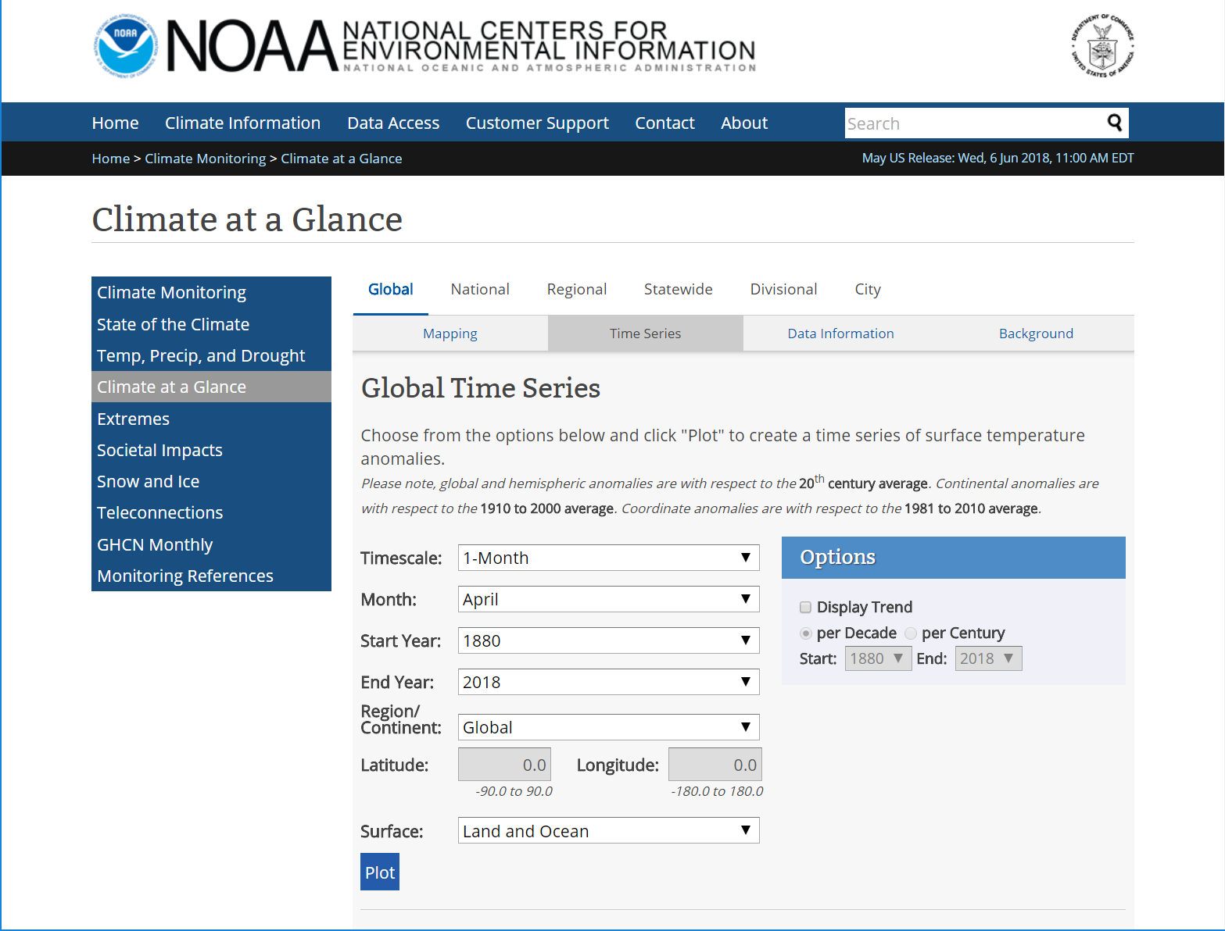
National Oceanic and Atmospheric Administration (NOAA)

Slide 10
National Oceanic and Atmospheric Administration (NOAA)
Scientific agency within the United States Department of Commerce
Historic record goes back to 1850
Provided calculated global average temperature anomalies
Earth divided into blocks
Computed average temperature for each block
Normalized to the 20th century average
Calculated estimates provided monthly
Zhang, H.-M., B. Huang, J. Lawrimore, M. Menne, Thomas M. Smith, NOAA Global Surface Temperature Dataset (NOAAGlobalTemp), Version 4.0 NOAA Global Surface Temperature Data. NOAA National Centers for Environmental Information. doi:10.7289/V5FN144H.

Slide 11
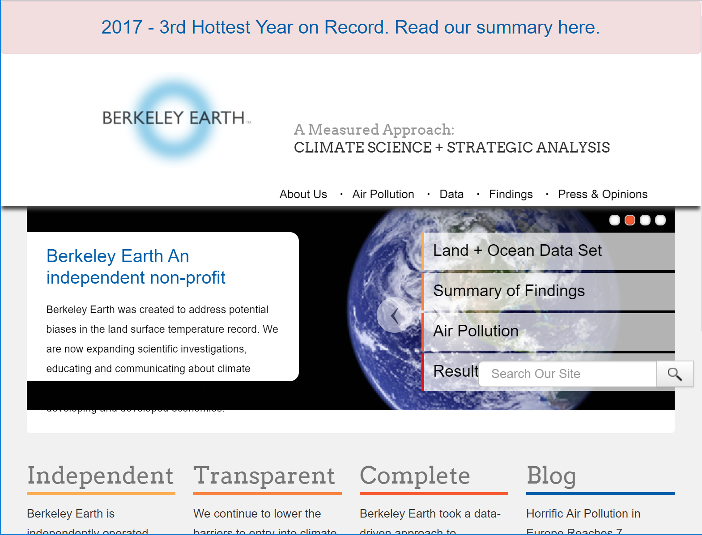
Berkeley Earth

Slide 12
Berkeley Earth
Berkeley Earth is independently operated, funded primarily by unrestricted educational grants
Mission: To pursue objectivity without concern for policies of government, industry or philanthropic ventures
Provides data repositories for various climate and environmental metrics

Slide 13
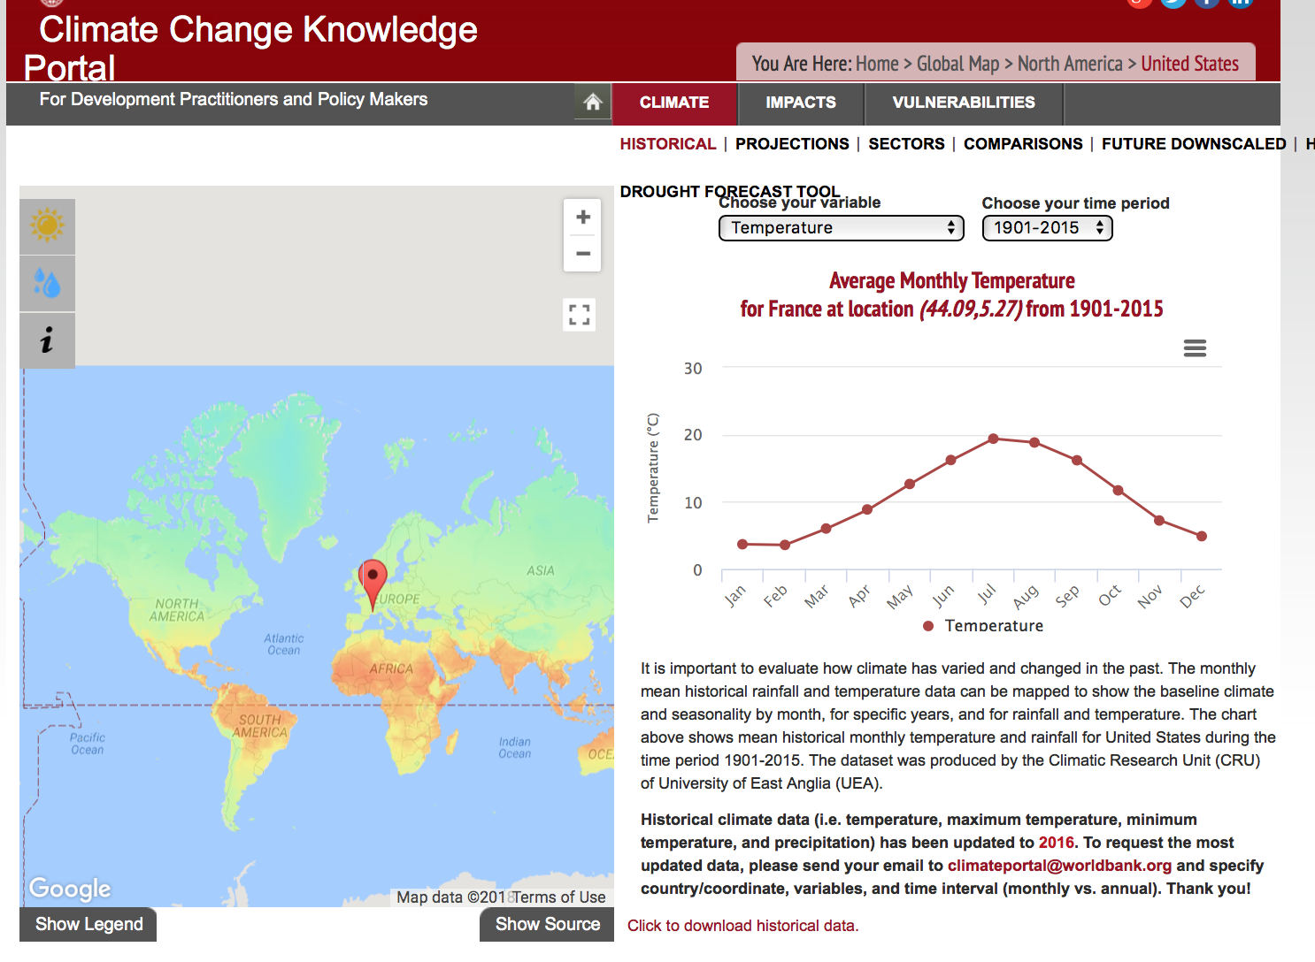
The World Bank Group

Slide 14
The World Bank Group
Multinational partnership amongst 170 countries worldwide
Mission: Seeking to improve global welfare
Provides data repositories for various things:
Population
Health
Social demographics
Economics
Education
Climate data!!

Slide 15
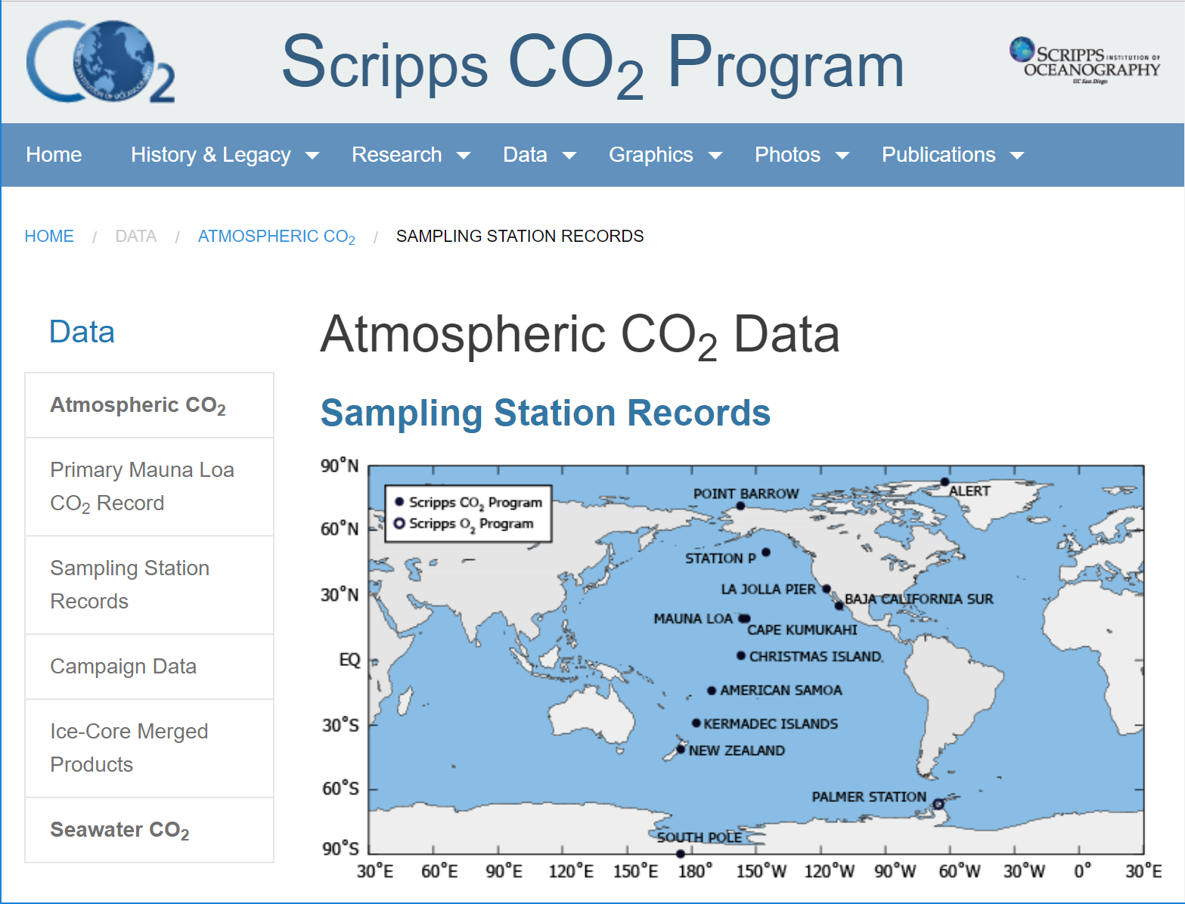
Scripps Institute of Oceanography

Slide 16
Scripps Institute of Oceanography
The Scripps Institute for Oceanography is a heralded forum for carbon dioxide research
Founder, Charles Keeling, considered first to alert about potential risks of greenhouse gas emissions
Operates has several sampling stations in the western hemisphere to gather CO2 data in parts per million

Slide 17
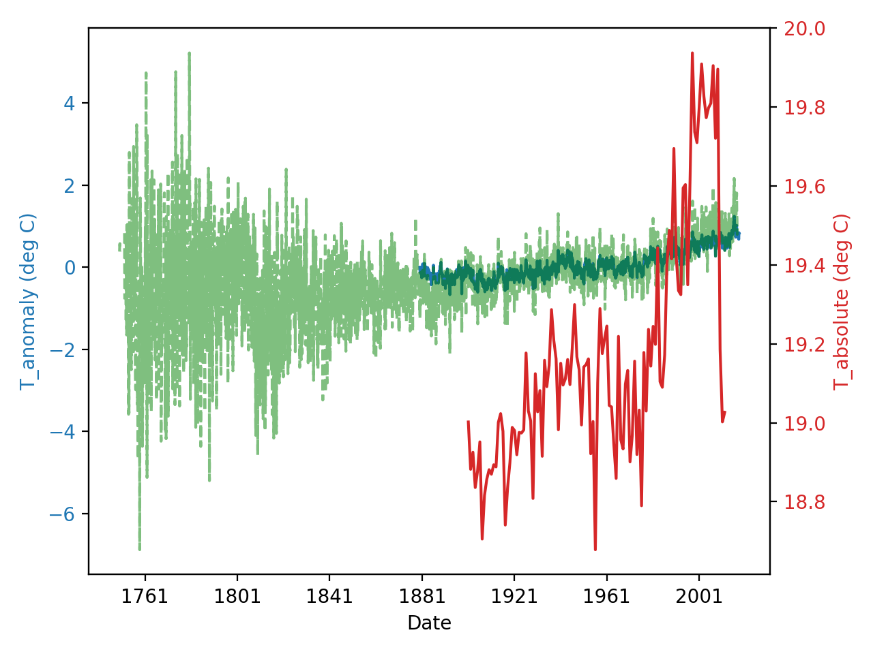
Demo

Slide 18
Design
Created functions to communicate with each of data sources with minimal functional signature
Use spreadsheet-like Pandas dataframe to ease data formatting
Created script to combine the average global temperature estimates into single graph
Encapsulated all functionality into Jupyter notebook for easy of use and expansion
Similarity with scientific journal paper format
Mathematical programming style chosen

Slide 19
Design
Main component: grab_ functions
Design to be consistent and simple
No required inputs
Optional inputs allowed
Outputs simple dataframe with 2 columns
Date
Temperature (absolute or anomaly)

Slide 20
Design
Main component: grab_ functions
Pandas read_html() / read_csv()
Access via API token and requests library
Clean and output into dataframe

Slide 21


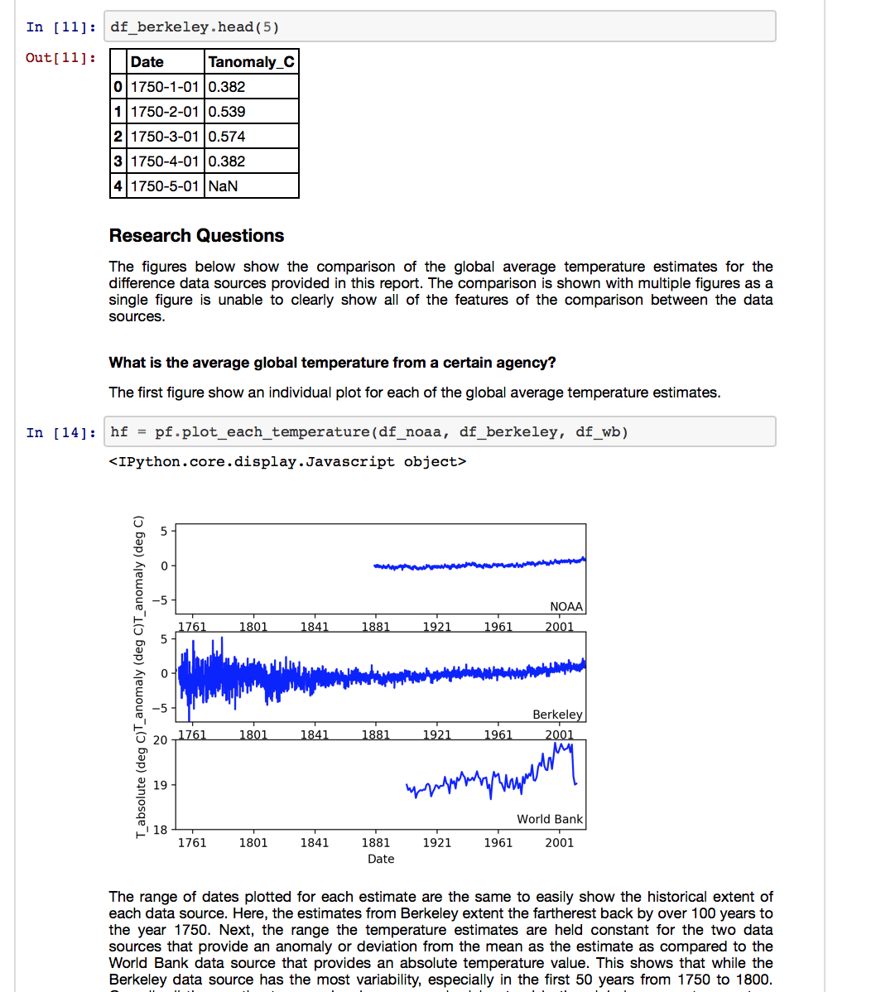


Design
grab_scripps_co2()
grab_noaa()
grab_berkeley()
grab_worldbank()

Slide 22
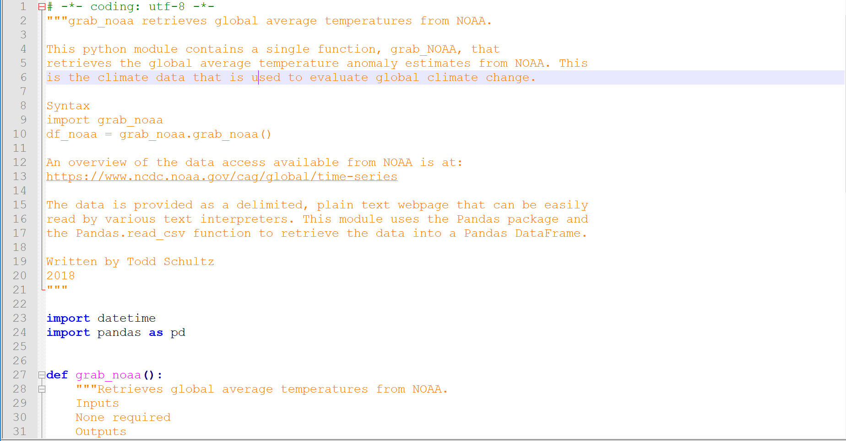
grab_noaa

Slide 23
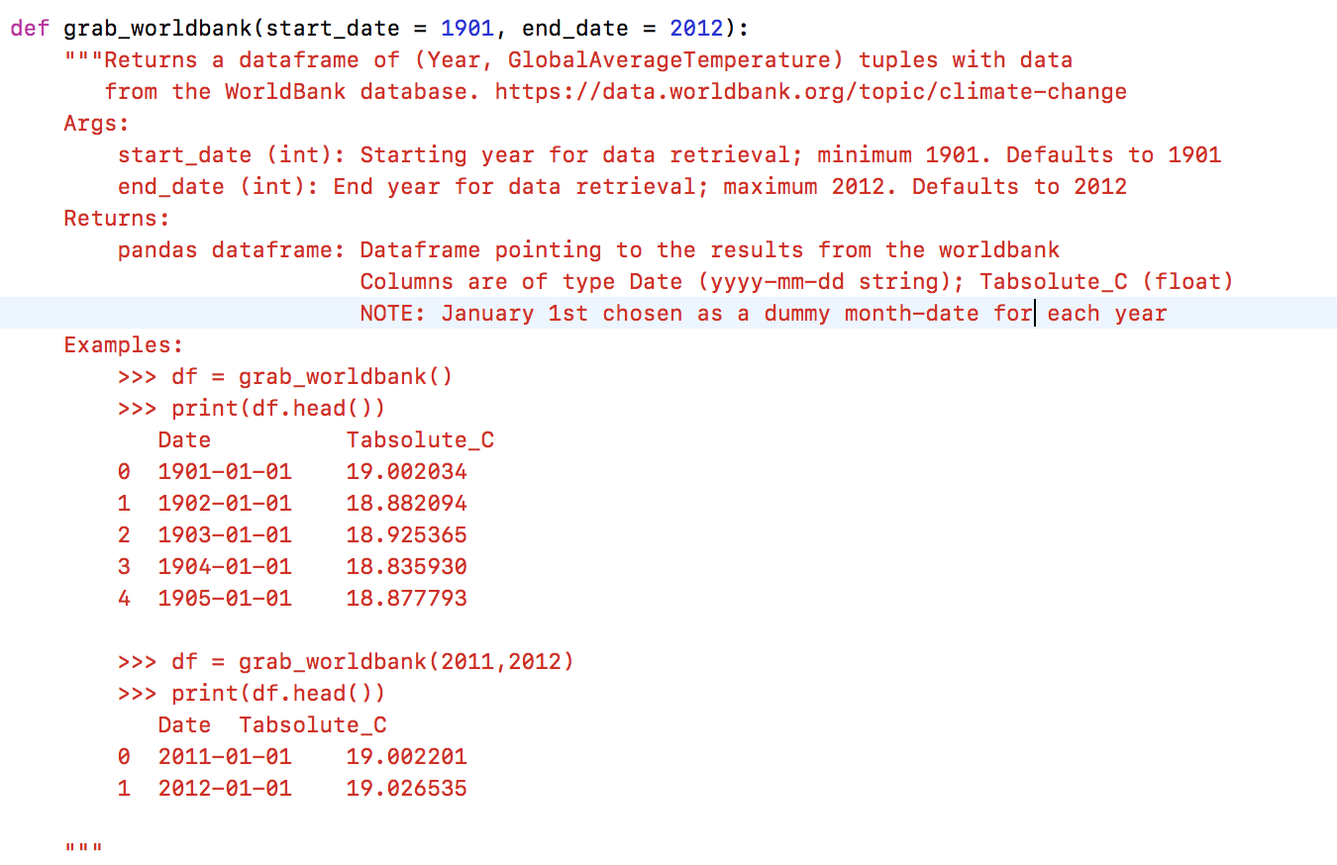
grab_worldbank

Slide 24
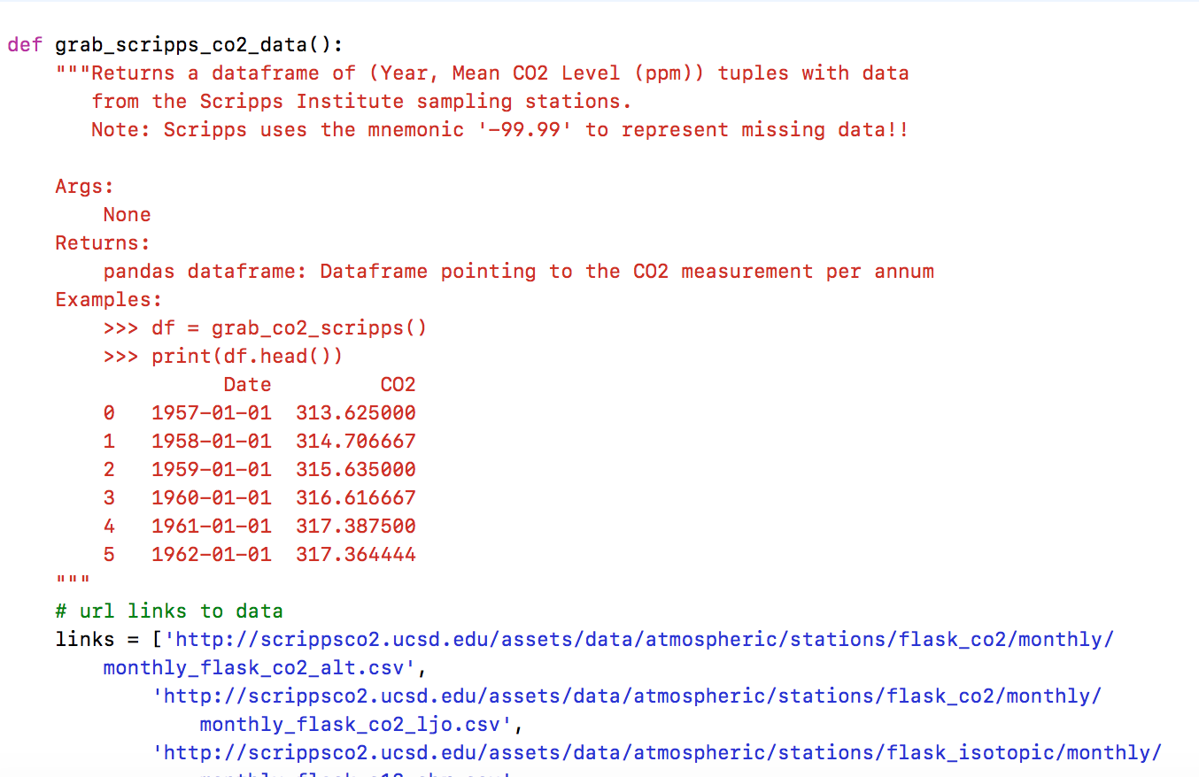
grab_scripps_co2_data

Slide 25
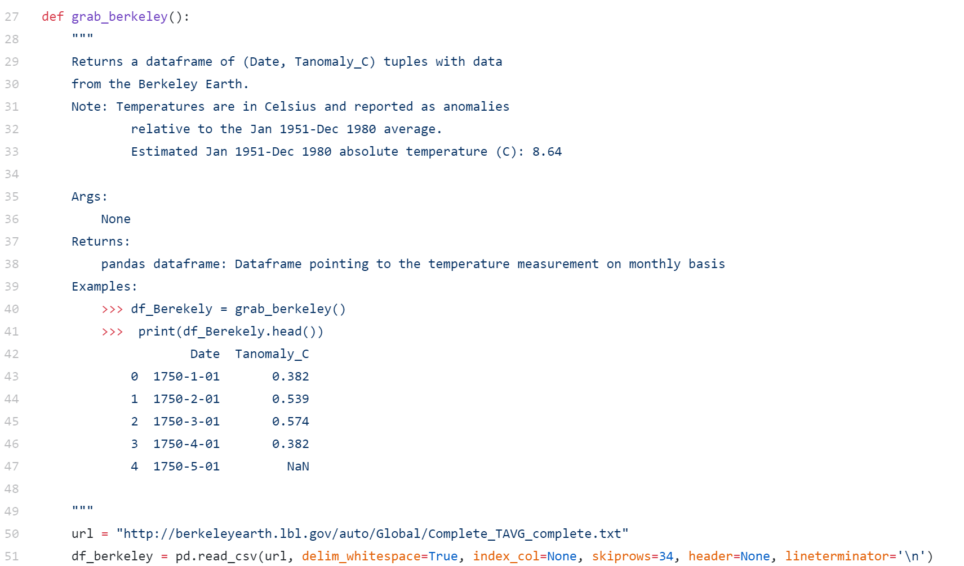
grab_berkeley

Slide 26
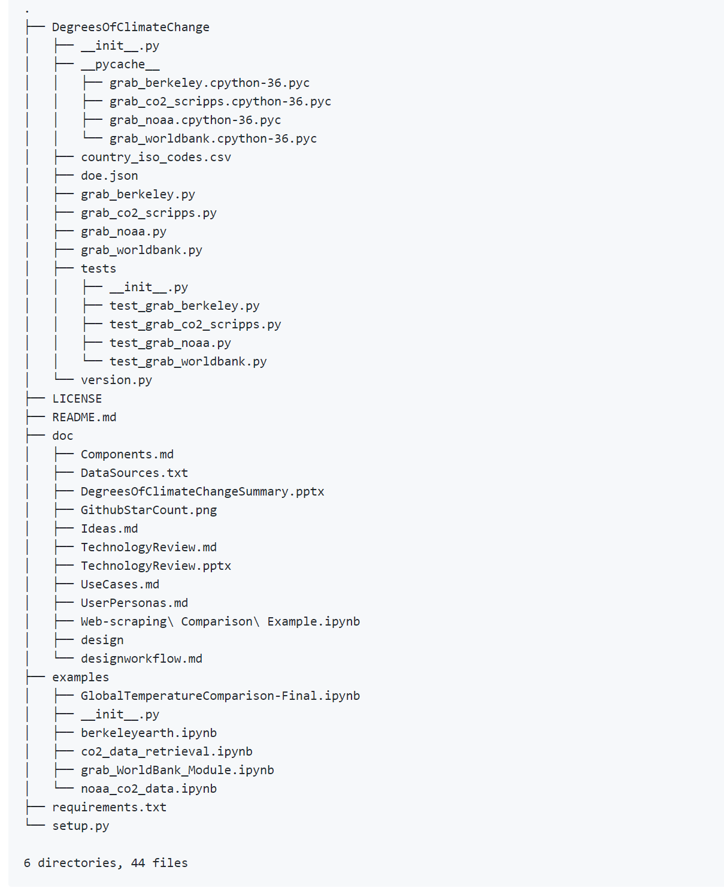
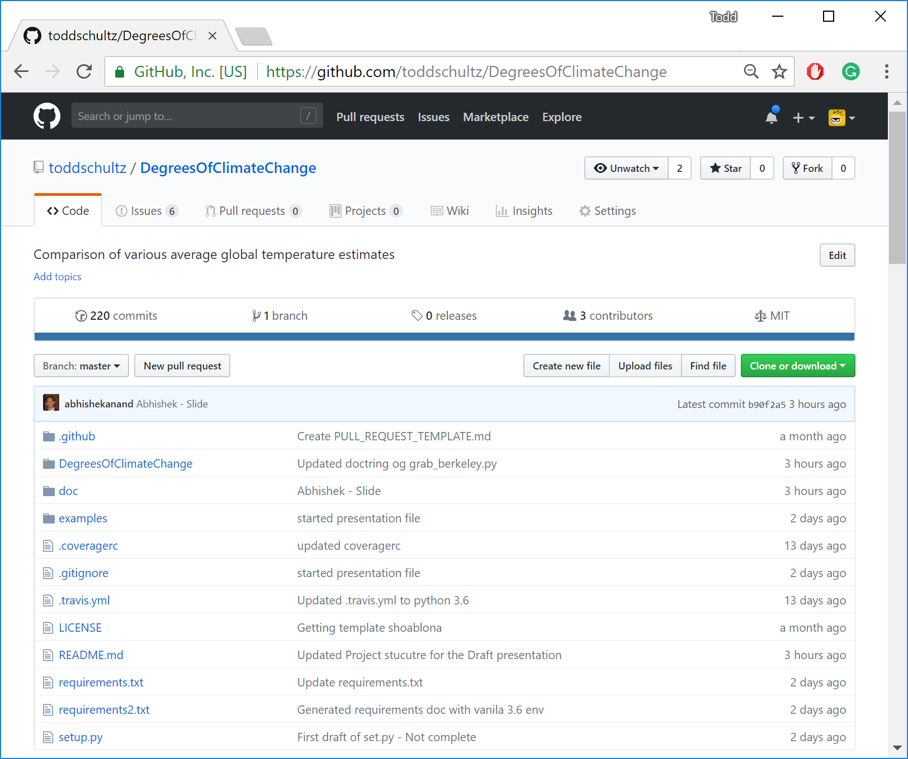
Project Structure
https://github.com/toddschultz/DegreesOfClimateChange

Slide 27
Project Hallmarks
SCIENTIFIC INQUIRY
Analysis shows some, perhaps significant.., discrepancies in temperature data ca. 1980+
There are degrees of climate change
UNITTESTS
Travis CI integrated
97% coverage
SCALABILITY
Easily scalable to new data sources
Reproducibility!
All modules/data fully 'on-line'
DATA SOURCES
Wide variety; obtained best possible given limitations
Did the grunt work of finding valid data

Slide 28
Lessons Learned
Data source provides don’t provide sufficient documentation on their web service APIs
Surprised by the difference in temperature metric between the agencies
Setting up imports to work with modules in different folders can be challenging
Setting up imports to work with Travis CI can be challenging

Slide 29
Future Work
Additional data sources
Increase geopolitical diversity of data source origins
Increase time scale of climate data
Geological time scale very large (~millions of years)
Add potential causal data sources
CO2 emissions
Solar activity
Improve data handling and visualizations
Find consistent estimates of the temperature anomaly instead of mixing deviations with absolute temperature values

Slide 30
Thanks

Slide 31
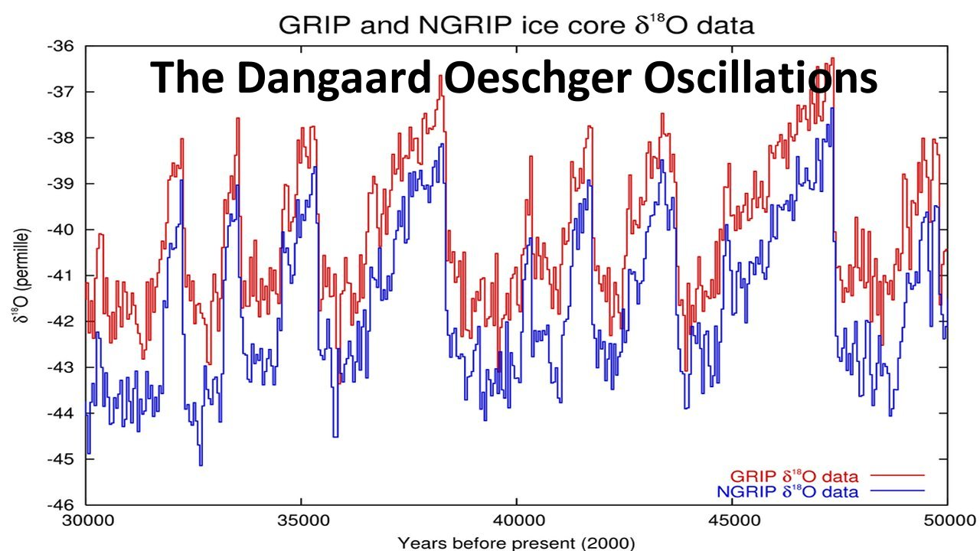
Future Work: Need Longer-Dated Climate & Temperature Data
Temperature Proxy
http://ice-age-ahead-iaa.ca/scrp-awake/laba027.htm

Slide 32
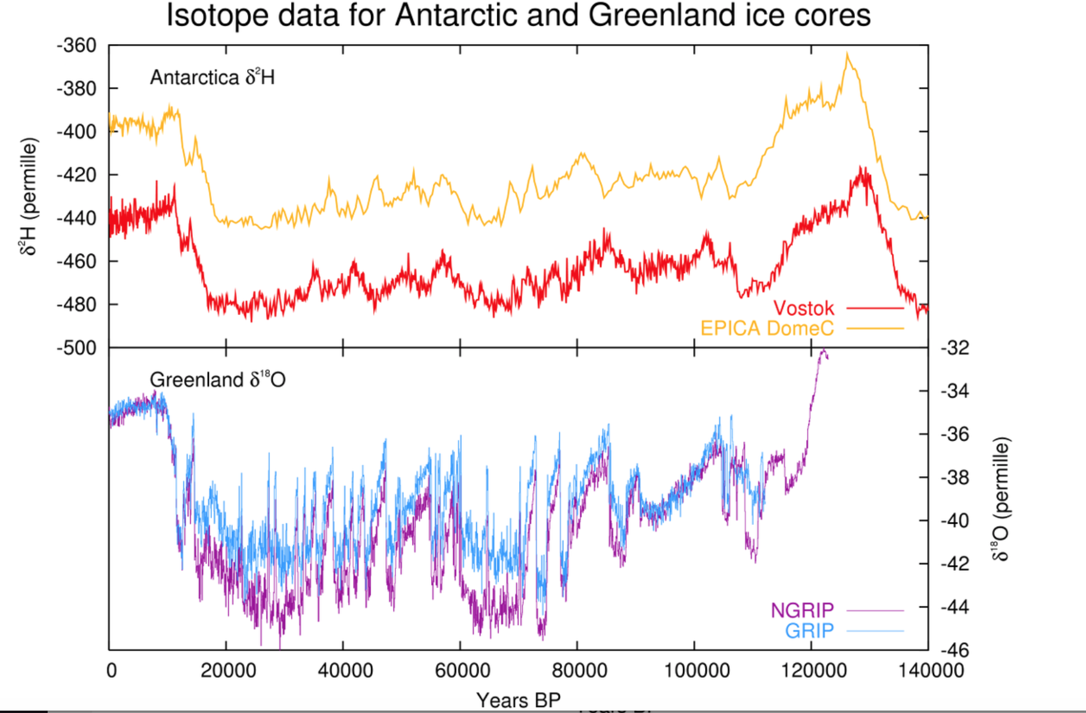
Data does not go back far enough!!
What if......our current data is biased I.e. we are only sampling in an "upswing"
Temperature Proxy
https://en.wikipedia.org/wiki/Dansgaard–Oeschger_event
Present
Prehistoric Age

